Slide 1



ONLINE PLACEMENT AGENCY
C-DAC Bangalore
PG-DAC
Project Group No. 09
ANKUR YADAV (220950120030)
ARVIND CHANDRAKAR (220950120038)
ASHISH VERMA (220950120042)
DOLLY TEOTIA (220950120069)
RICHA SHARMA (220950120147)
Supervisor : Mr. Harshvardhan
Center for Development of Advanced Computing

Slide 2

C-DAC Bangalore
INTRODUCTION
MOTIVATION
OBJECTIVE
TECHNILOGY USED
UML DIAGRAM
SCREENSHOTS
S/W AND H/W REQUIREMENTS
FUTURE SCOPE
CONCLUSION
REFERENCES

Slide 3
C-DAC Bangalore
INTRODUCTION
Online Placement Agency is a Online Web Portal, which is developed to provide efficient platform to post vacancies and to search for required job.
This is a portal which will be available for 24/7.
There are 3 major component of this portal, 1st Admin, 2nd Employer, and 3rd User.
Admin has full control over the Employer and the User. Admin handles Management on both the components.
Employer is here to post the vacancies and search for the perfect candidate for there vacancies.
User can search for job of the respective field.

Slide 4
C-DAC Bangalore
MOTIVATION
As we know that searching of jobs is so difficult in proficient areas, so this portal is developed to providing the simple and good job searching.
With the help of this portal easily the job seeker can search for job from there interested and respective field and get the lot of opportunity of the job related to their profile.
And by this website the companies or employer can also find the good and well profiled candidate.

Slide 5
C-DAC Bangalore
OBJECTIVE
The Online Placement System is a Portal that is to be developed to provide the members with jobs information, online applying for jobs and many other facilities.
This system provides service to the job applicants to search for working opportunities.
This Portal will allow job provider to establish one to one relationships with candidates.
This Portal will primarily focus on the posting and management of job vacancies.
This system is designed such that ultimately all vacancies will be posted online and would offer employers the facilities to post their vacancies online.
By this user can easily search for JOB for their respective field.

Slide 6
C-DAC Bangalore
TECHNILOGY USED
Front End : For front end ReactJS has been used.
Back End : For back end Spring Boot has been used.
Back End Database : For back end database MySQL has been used.

Slide 7
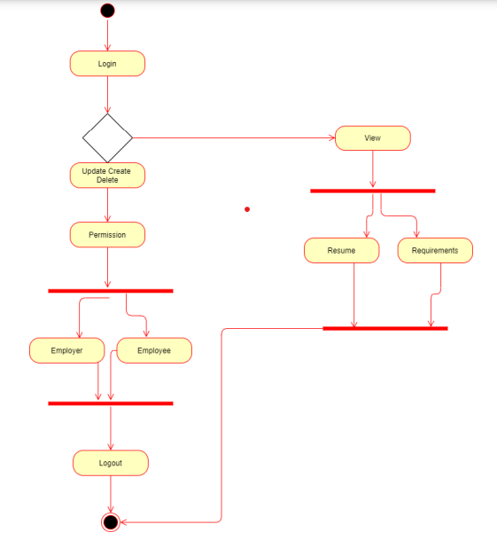
C-DAC Bangalore
UML DIAGRAM
Admin

Slide 8
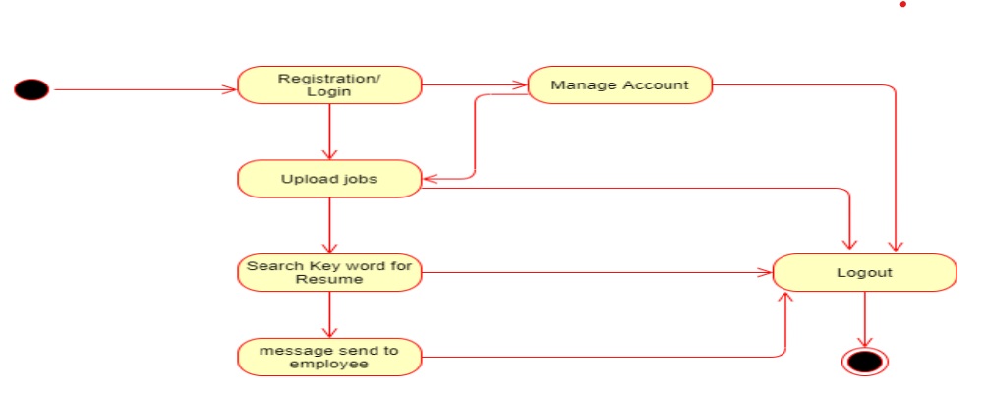
C-DAC Bangalore
UML DIAGRAM
Employer

Slide 9
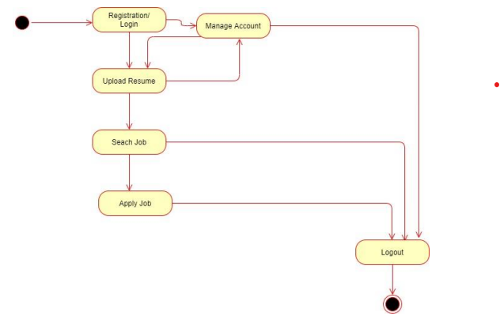
C-DAC Bangalore
UML DIAGRAM
User

Slide 10
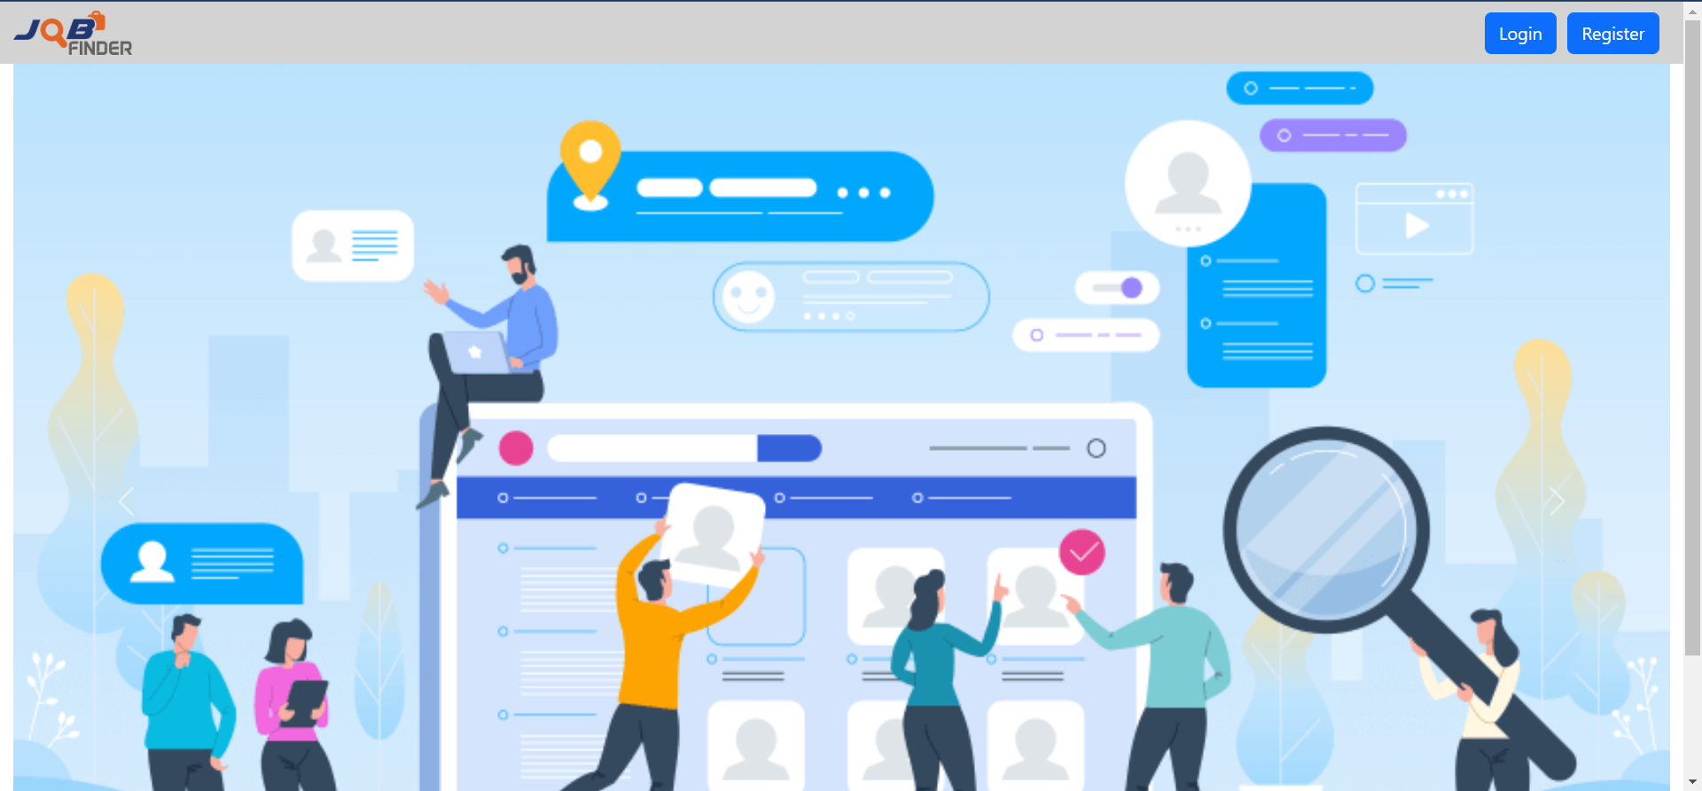
C-DAC Bangalore
SCREENSHOTS
Home Page

Slide 11
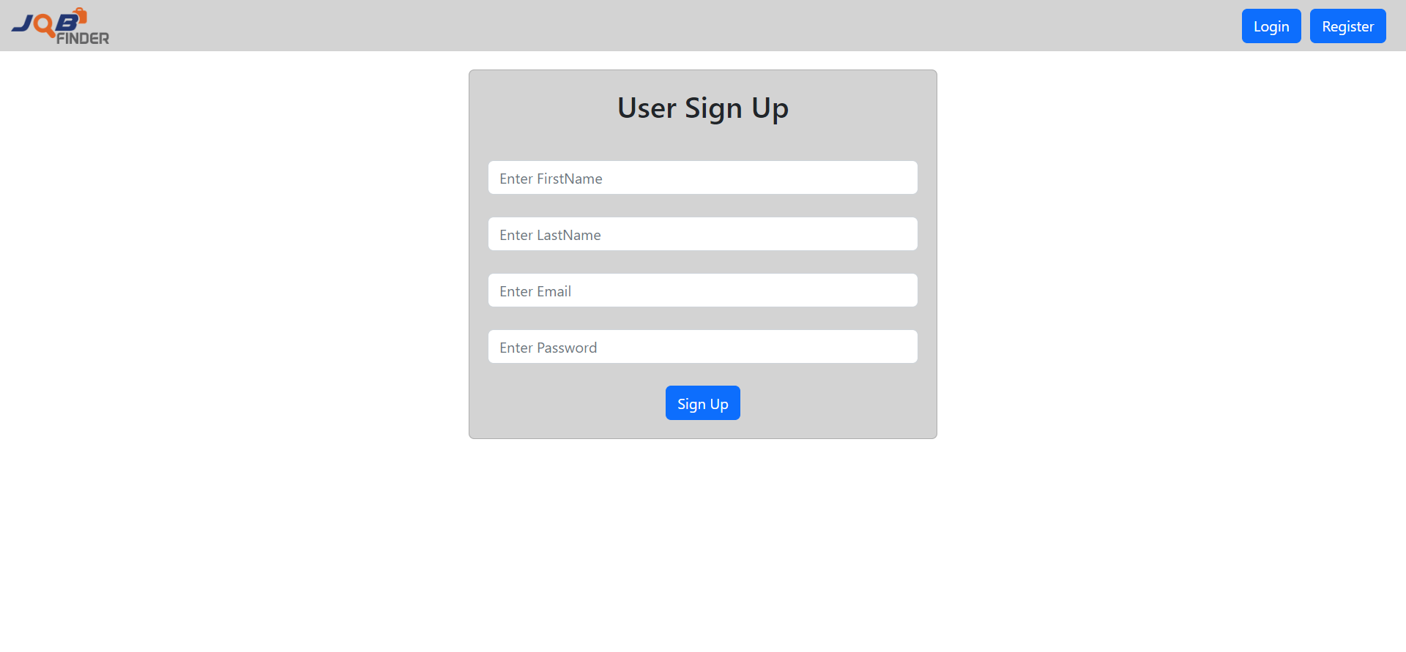
C-DAC Bangalore
SCREENSHOTS
Sign Up Page

Slide 12
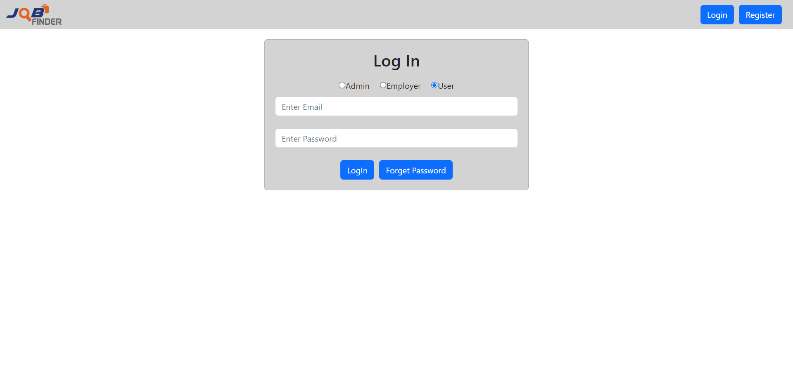
C-DAC Bangalore
SCREENSHOTS
Log In Page

Slide 13
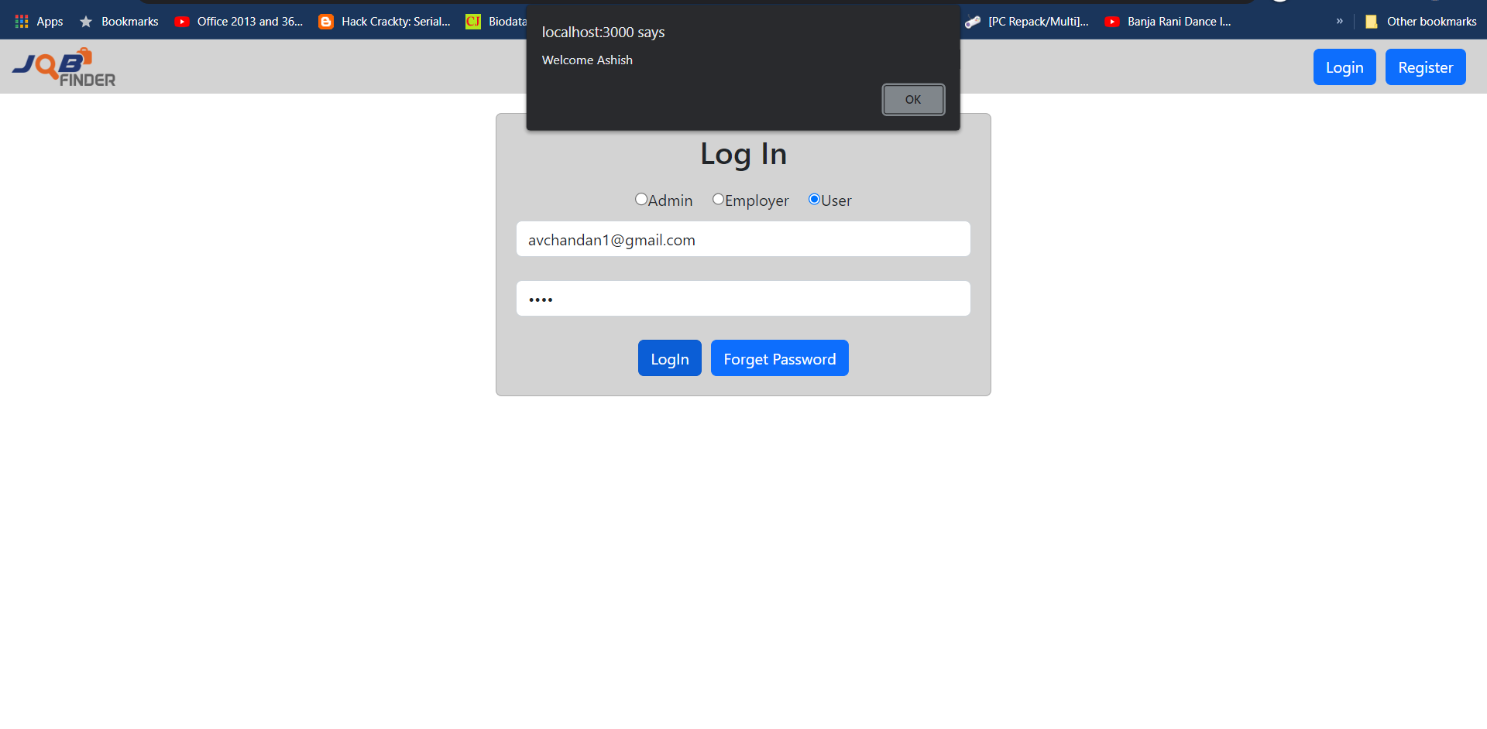
C-DAC Bangalore
SCREENSHOTS
Log In Confirmation

Slide 14
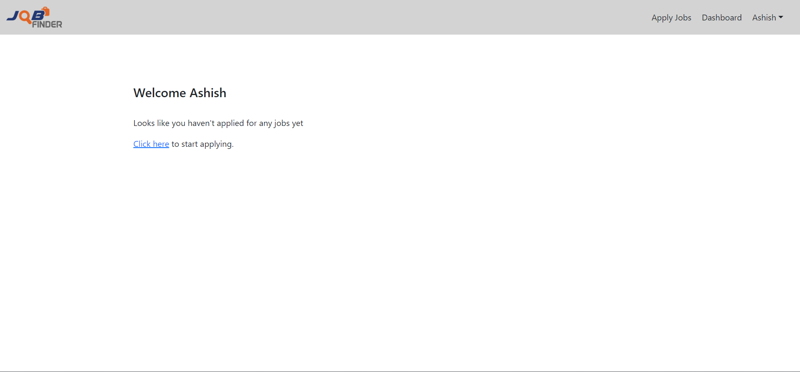
C-DAC Bangalore
SCREENSHOTS
User Empty Dashboard

Slide 15
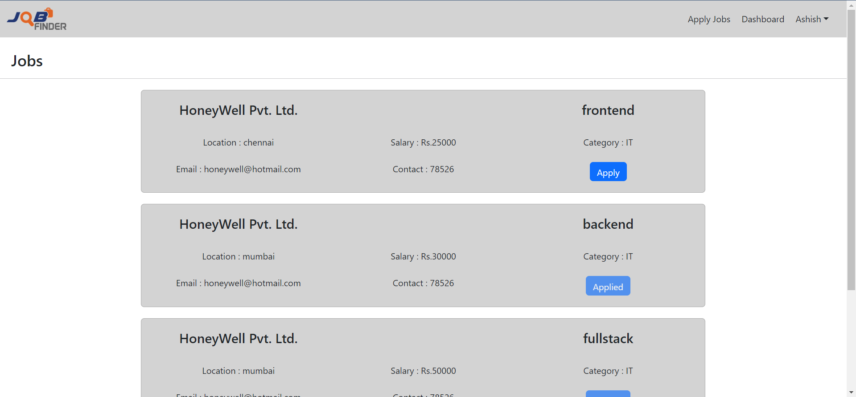
C-DAC Bangalore
SCREENSHOTS
All Job List

Slide 16
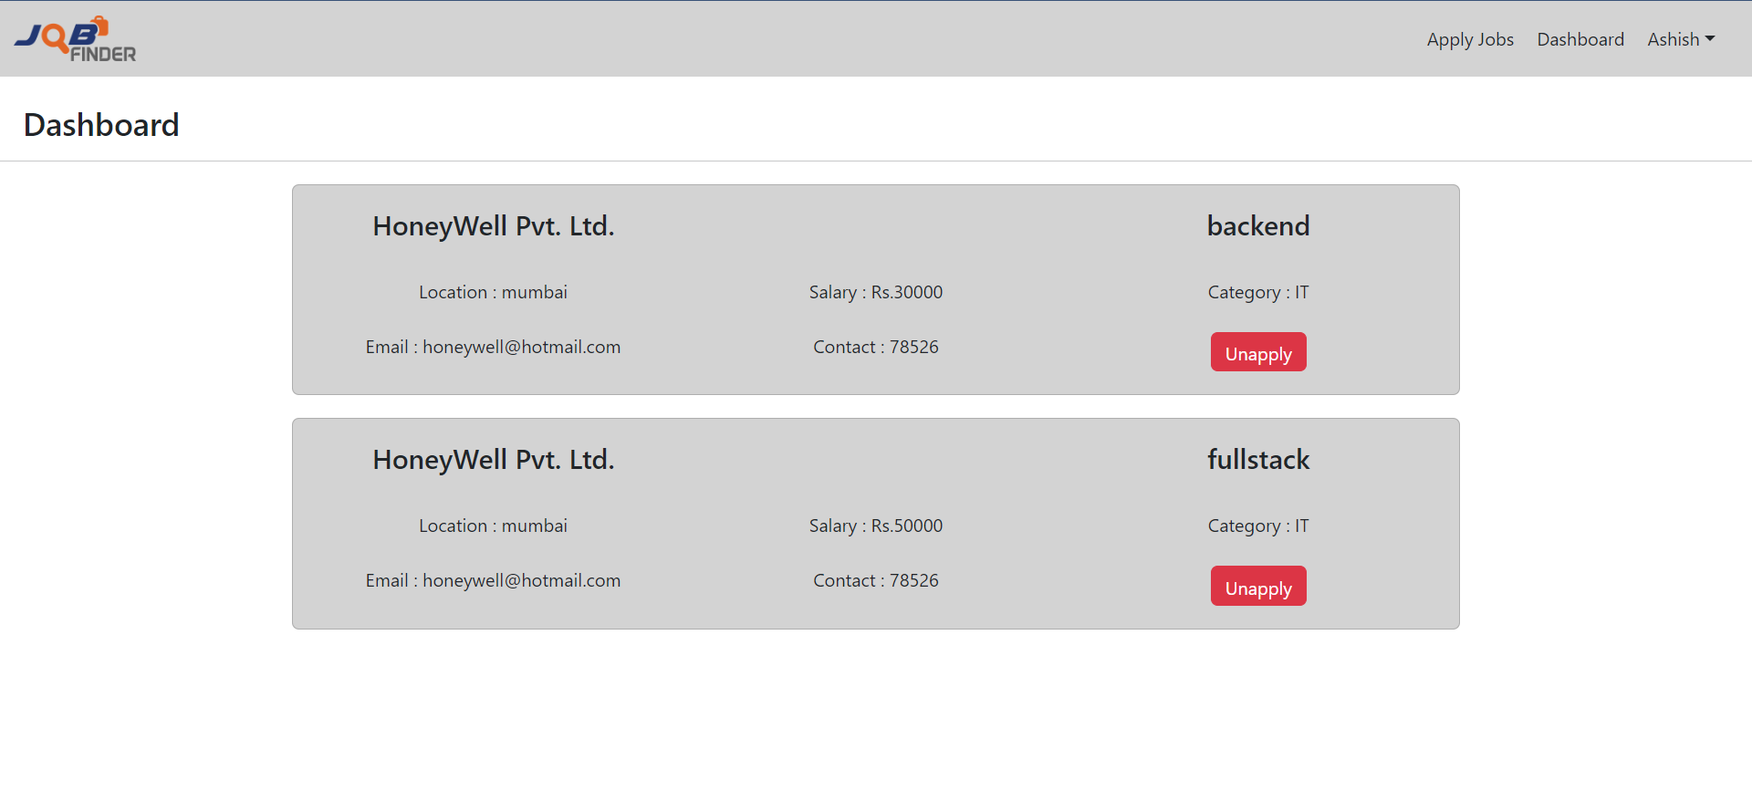
C-DAC Bangalore
SCREENSHOTS
User Dashboard

Slide 17
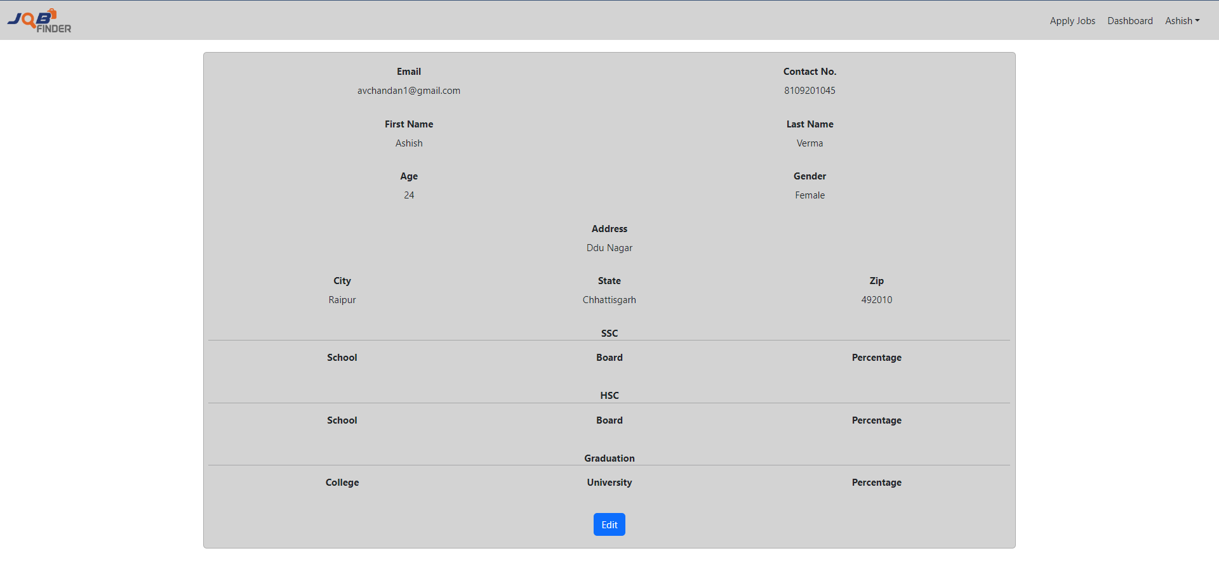
C-DAC Bangalore
SCREENSHOTS
User Profile

Slide 18
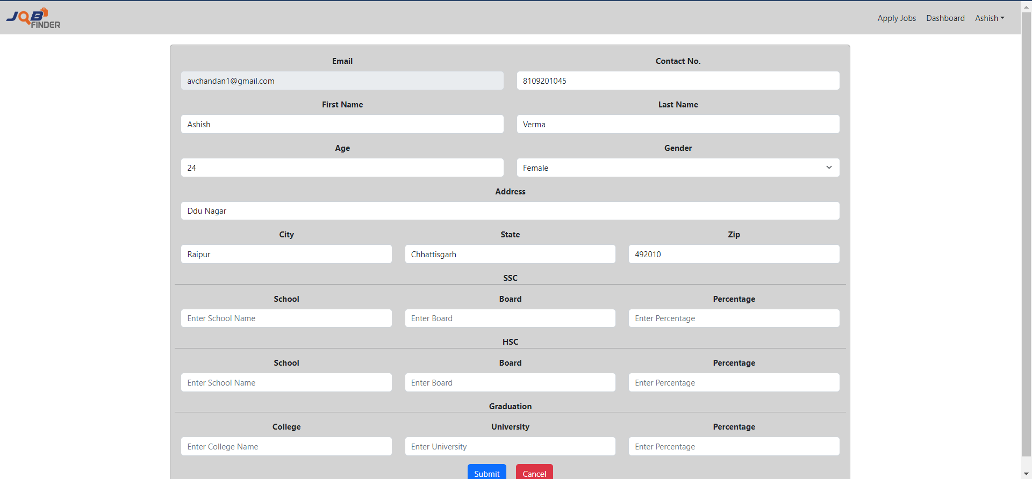
C-DAC Bangalore
SCREENSHOTS
User Profile Edit

Slide 19
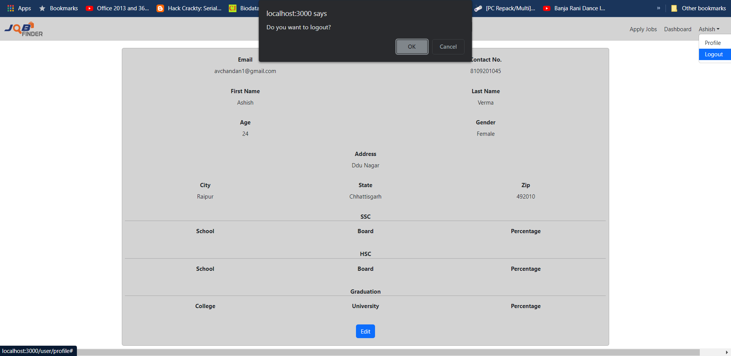
C-DAC Bangalore
SCREENSHOTS
Logout Confirmation

Slide 20
C-DAC Bangalore
S/W AND H/W REQUIREMENTS
SERVER SIDE :-
Processor: Intel® Xeon® processor 3500 series
HDD: Minimum 500GB Disk Space
RAM: Minimum 4GB
OS: Windows 10
Database: MySQL
CLIENT SIDE (minimum requirement) :-
Processor: Intel Dual Core
HDD: Minimum 80GB Disk Space
RAM: Minimum 2GB
OS: Windows 7

Slide 21
C-DAC Bangalore
FUTURE SCOPE
This project can be enhanced further by adding some more features. The application is design in such a way that any further enhancements can be done with ease.
The system has the capability for easy integration with other systems.
New modules can be added to the existing system with less effort.
In future a new function or procedure can be easily added in the system through these classes. Or even a new class can be added.
The software is flexible enough to be modified and implemented as per future requirements. We have tried our best to present this free and user–friendly website to Regional Offices.

Slide 22
C-DAC Bangalore
CONCLUSION
It has been a great pleasure for us to work on this exciting and challenging project. This project proved good for us as it provided practical knowledge of not only programming in JAVA and JavaScript web based application and no some extent Windows Application and SQL Server, but also about all handling procedure related with Online Placement Agency.
It also provides knowledge about the latest technology used in developing web enabled application and client server technology that will be great demand in future. This will provide better opportunities and guidance in future in developing projects independently.

Slide 23
C-DAC Bangalore
REFERENCES
React Tutorial (w3schools.com)
Learn Spring Boot | Baeldung
Spring Data JPA - Reference Documentation
React – A JavaScript library for building user interfaces (reactjs.org)
Bootstrap · the most popular HTML, CSS, and JS library in the world. (getbootstrap.com)

Slide 24



C-DAC Bangalore
THANK YOU
CONTACT US :
avchandan1@gmail.com
richa.sharma2226@gmail.com
PG –DAC/DITISS
Center for Development of Advanced Computing

